Slide 1
Deep Learning and Neural Nets in Plain English
Khiati Zakaria

Slide 2
Contents
Artificial Intelligence
Data Mining
Machine Learning
Deep Learning
AlphaGo

Slide 3
Artificial Intelligence

Slide 4
Artificial Intelligence
Artificial Intelligence
Ability of machines in conducting intelligent tasks
Intelligent Programs
Programs conducting specific intelligent tasks
Intelligent Processing
Input
Output

Slide 5
Data Mining

Slide 6
Introduction
Vast amounts of data are around us in our world, raw data that is mainly intractable for human or manual applications.
Data Mining is about solving problems by analyzing data present in real databases.
Data Mining is distinguished as synonym of the Knowledge Discovery in Databases (KDD) process, or as the main step of KDD.
KDD definition: “the nontrivial process of identifying valid, novel, potentially useful, and ultimately understandable patterns in data”

Slide 7
Stages
Problem Specification
Problem Understanding
Data Preprocessing
Data Mining
Evaluation
Results Exploitation

Slide 8
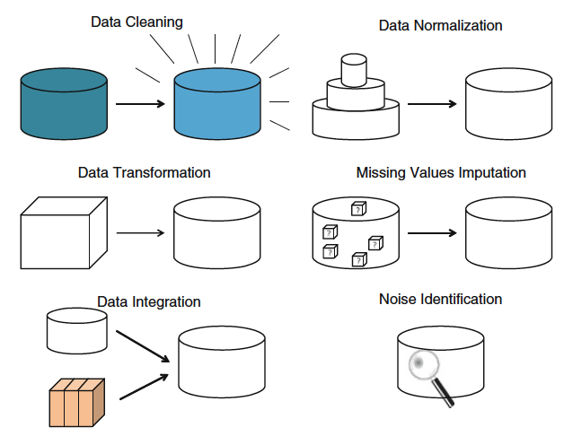
Data Preprocessing

Slide 9
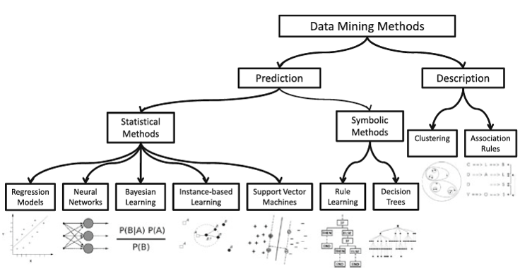
Data Mining methods

Slide 10
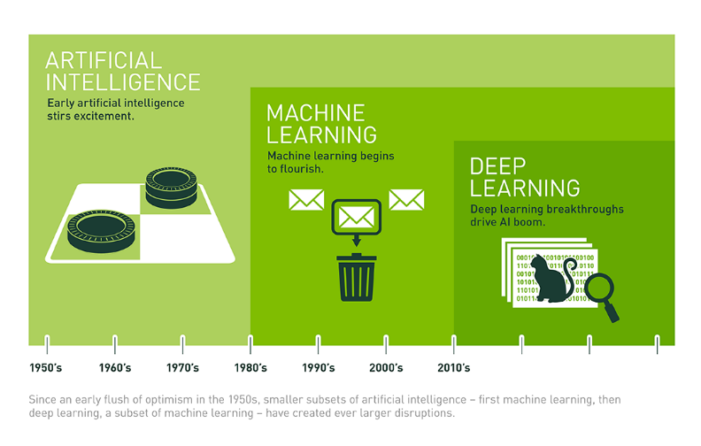
Artificial Intelligence (AI) vs Data Mining (DM) vs Machine Learning (ML) vs Deep Learning (DL)
Data Mining, Big Data
Rule Based Programming

Slide 11
Machine Learning

Slide 12
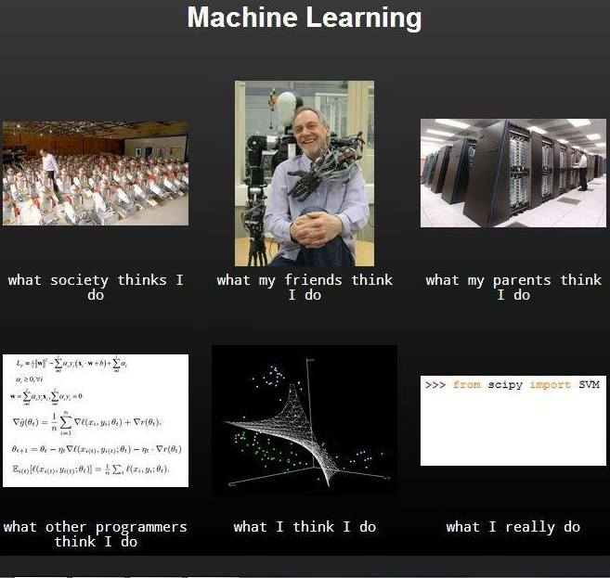

Slide 13
Introduction
“Machine learning, a branch of artificial intelligence, concerns the construction and study of systems that can learn from data.”
(Wikipedia)
“Machine learning is programming computers to optimize a performance criterion using example data or past experience.”
(Ethem Alpaydin)
“The goal of machine learning is to develop methods that can automatically detect patterns in data, and then to use the uncovered patterns to predict future data or other outcomes of interest.”
(Kevin P. Murphy)
“Machine learning is about predicting the future based on the past.”
(Hal Daume III)

Slide 14
Introduction
Past
Future
Learn
Predict
Training
Data
Testing
Data
Model
Model
Answer

Slide 15
Why Machine Learning?
No human experts
Industrial/manufacturing control
Mass spectrometer analysis, drug design, astronomic discovery
Black-box human expertise
Face, handwriting and speech recognition
Driving a car or flying a plane
Rapidly changing phenomena
Credit scoring, financial modeling
Diagnosis, fraud detection
Need for customization/personalization
Personalized news reader
Movie/book recommendation

Slide 16
Related fields
Statistics
Information theory
machine
learning
Decision theory
Data
mining
cognitive science
Databases
Psychological models
Neuroscience
Control theory

Slide 17
Traditional programming vs machine learning
Data
Computer
Output
Program
Data
Computer
Program
Output

Slide 18
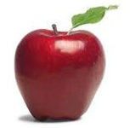
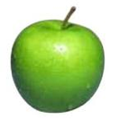
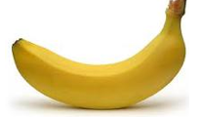
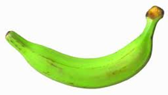
Data
Data

Slide 19

Data
Data

Slide 20

Data
Data

Slide 21
Supervised learning (Classification)
Apple
Training
Apple
Model
Banana
Banana

Slide 22
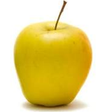
Supervised learning (Classification)
Input
Predicting
Model
Label

Slide 23
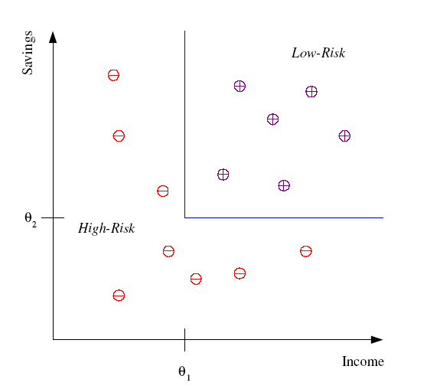
Supervised learning (Classification)
Differentiate between low-risk and high-risk customers from their income and savings

Slide 24
Supervised learning (Classification)
Face, iris, signature recognition (Security, Phone, Camera)
Handwriting recognition (Banks, Post offices)
Spam detection
Medical diagnosis: From symptoms to illnesses
Object recognition

Slide 25
Supervised learning (Regression)
-4.5
10.1
Regression: label is real-valued
3.2
4.3

Slide 26
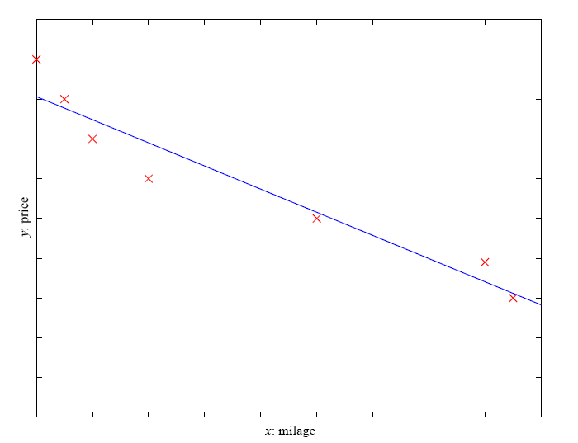
Supervised learning (Regression)
Price of a used car
x : car attributes (e.g. mileage)
y : price

Slide 27
Supervised learning (Regression)
Economics/Finance: predict the value of a stock
Epidemiology
Car/plane navigation: angle of the steering wheel, acceleration
Temporal trends: weather over time

Slide 28
Supervised learning (Ranking)
1
2
Ranking: label is a ranking
3
4

Slide 29
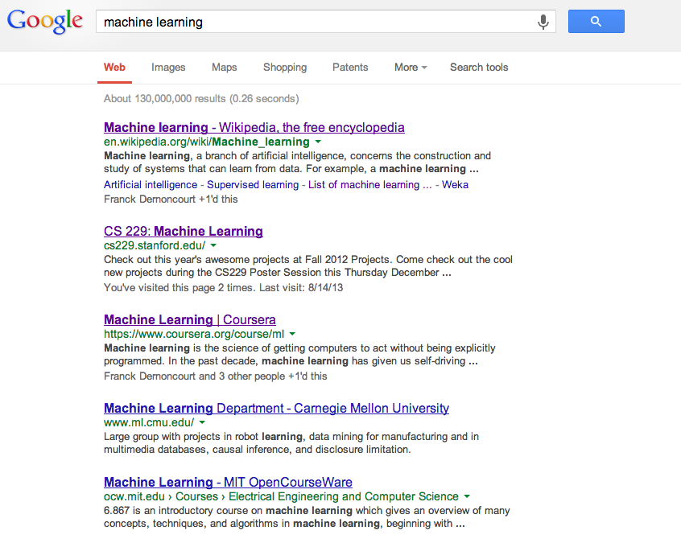
Supervised learning (Ranking)
Given a query and
a set of web pages,
rank them according
to relevance

Slide 30
Supervised learning (Ranking)
User preference, e.g. Netflix
Search ranking, e.g. Google
iTunes
Flight search (search in general)

Slide 31
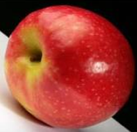
Unsupervised learning
Unsupervised learning: given data but no labels

Slide 32
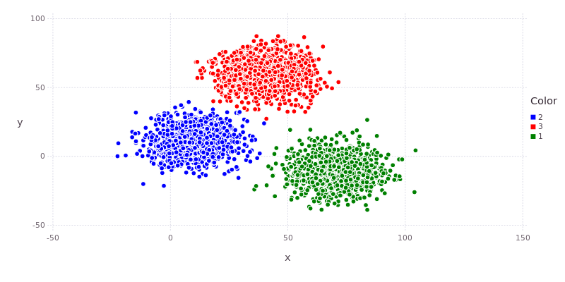
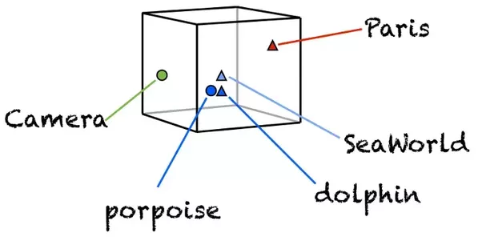
Unsupervised learning
Clustering
Word Embedding
Customer segmentation (i.e. grouping)
Image compression
Bioinformatics: learn motifs

Slide 33
Reinforcement learning
Given a sequence of examples/states and a reward after completing that sequence, learn to predict the action to take in for an individual example/state
left, right, straight, left, left, left, straight
GOOD
left, straight, straight, left, right, straight, straight
BAD
left, right, straight, left, left, left, straight
+5
left, straight, straight, left, right, straight, straight
-5

Slide 34
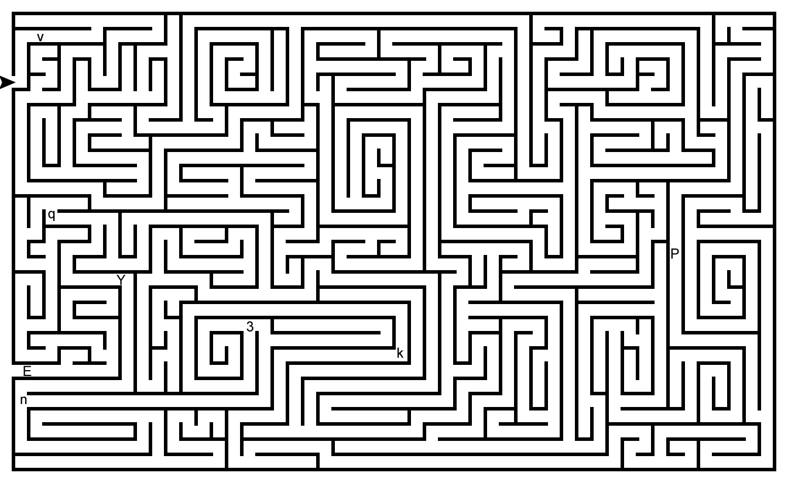
Reinforcement learning

Slide 35
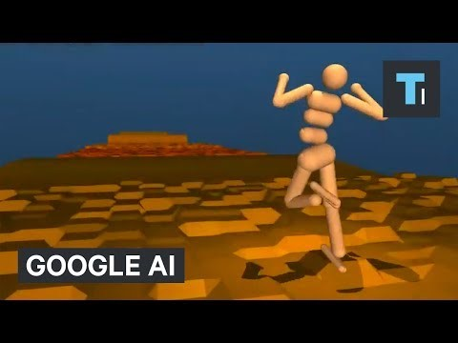
Reinforcement learning

Slide 36
Other types of learning
What data is available:
Supervised, Unsupervised, Reinforcement learning
Semi-supervised, Active learning, …
How are we getting the data:
Online vs. Offline learning
Type of model:
Generative vs. Discriminative
Parametric vs. Non-parametric

Slide 37
Deep Learning

Slide 38
Introduction
AKA. deep neural networks, deep Neural nets…
How most researchers in computer science heard of it: Deep Learning is providing breakthrough results in speech recognition and image classification …
So what exactly is deep learning ? And why is it generally better than other methods on image, speech and certain other types of data?
The short answers:
‘Deep Learning’ means using a neural network with several layers of nodes between input and output
The series of layers between input & output do feature identification and processing in a series of stages, just as our brains seem to

Slide 39
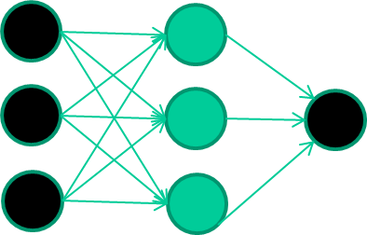
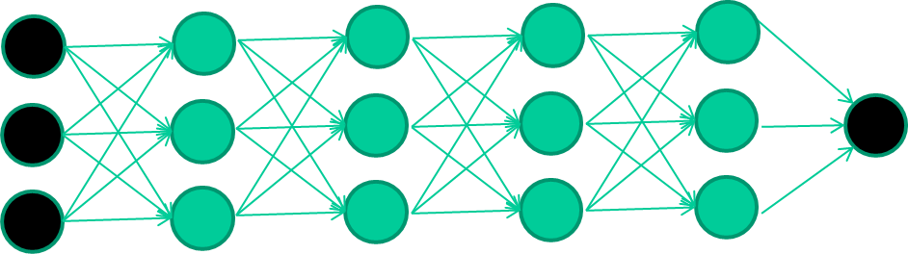
Introduction
Multilayer neural networks have been around for 25 years. What’s actually new?
We have always had good algorithms for learning the weights in networks with 1 hidden layer, but these algorithms are not good at learning the weights for networks with more hidden layers
what’s new is: algorithms for training many-layer networks
Input layer
Hidden layer
Output layer

Slide 40
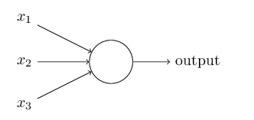
Perceptrons
Weights (W1, W2, W3)
Input
Results or output
Threshold
X1*W1+X2*W2+X3*W3

Slide 41
Perceptrons
Suppose the weekend is coming up, and you've heard that there's going to be a cheese festival in your city. You like cheese, and are trying to decide whether or not to go to the festival.
Is the weather good? (X1 binary, 1 for True and 0 for False)
Does your boyfriend or girlfriend want to accompany you? (X2 binary, 1 for True and 0 for False)
Is the festival near public transit? (X3 binary, 1 for True and 0 for False)
X1 = 1 W1 = 6
X2 = 0 W2 = 2
X3 = 0 W3 = 2
Threshold = 5
Result = Go

Slide 42
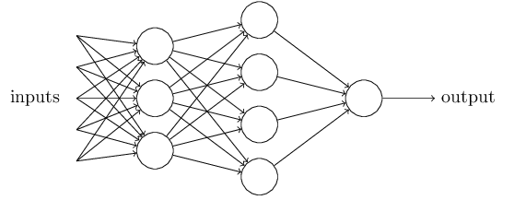
Network of perceptrons

Slide 43
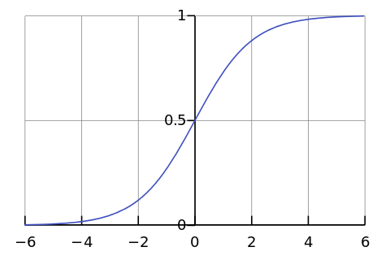

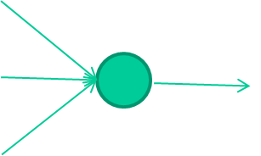
-0.06
W1
W2
f(x)
-2.5
W3
1.4

Slide 44
-0.06
2.7
-8.6
f(x)
-2.5
0.002
x = -0.06×2.7 + 2.5×8.6 + 1.4×0.002 = 21.34
1.4

Slide 45
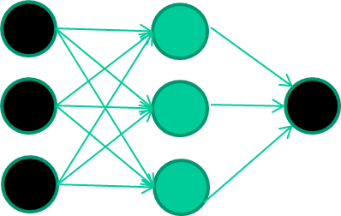
A dataset
Fields class
1.4 2.7 1.9 0
3.8 3.4 3.2 0
6.4 2.8 1.7 1
4.1 0.1 0.2 0
etc …

Slide 46
Training the neural network
Fields class
1.4 2.7 1.9 0
3.8 3.4 3.2 0
6.4 2.8 1.7 1
4.1 0.1 0.2 0
etc …

Slide 47
Training data
Fields class
1.4 2.7 1.9 0
3.8 3.4 3.2 0
6.4 2.8 1.7 1
4.1 0.1 0.2 0
etc …
Initialise with random weights

Slide 48
Training data
Fields class
1.4 2.7 1.9 0
3.8 3.4 3.2 0
6.4 2.8 1.7 1
4.1 0.1 0.2 0
etc …
Present a training pattern
1.4
2.7
1.9

Slide 49
Training data
Fields class
1.4 2.7 1.9 0
3.8 3.4 3.2 0
6.4 2.8 1.7 1
4.1 0.1 0.2 0
etc …
Feed it through to get output
1.4
2.7 0.8
1.9

Slide 50
Training data
Fields class
1.4 2.7 1.9 0
3.8 3.4 3.2 0
6.4 2.8 1.7 1
4.1 0.1 0.2 0
etc …
Compare with target output
1.4
2.7 0.8
0
1.9 error 0.8

Slide 51


Training data
Fields class
1.4 2.7 1.9 0
3.8 3.4 3.2 0
6.4 2.8 1.7 1
4.1 0.1 0.2 0
etc …
Adjust weights based on error
1.4
2.7 0.8
0
1.9 error 0.8

Slide 52
Training data
Fields class
1.4 2.7 1.9 0
3.8 3.4 3.2 0
6.4 2.8 1.7 1
4.1 0.1 0.2 0
etc …
Present a training pattern
6.4
2.8
1.7

Slide 53
Training data
Fields class
1.4 2.7 1.9 0
3.8 3.4 3.2 0
6.4 2.8 1.7 1
4.1 0.1 0.2 0
etc …
Feed it through to get output
6.4
2.8 0.9
1.7

Slide 54
Training data
Fields class
1.4 2.7 1.9 0
3.8 3.4 3.2 0
6.4 2.8 1.7 1
4.1 0.1 0.2 0
etc …
Compare with target output
6.4
2.8 0.9
1
1.7 error -0.1

Slide 55
Training data
Fields class
1.4 2.7 1.9 0
3.8 3.4 3.2 0
6.4 2.8 1.7 1
4.1 0.1 0.2 0
etc …
Adjust weights based on error
6.4
2.8 0.9
1
1.7 error -0.1

Slide 56
Training data
Fields class
1.4 2.7 1.9 0
3.8 3.4 3.2 0
6.4 2.8 1.7 1
4.1 0.1 0.2 0
etc …
And so on ….
6.4
2.8 0.9
1
1.7 error -0.1
Repeat this thousands, maybe millions of times – each time
taking a random training instance, and making slight
weight adjustments
Algorithms for weight adjustment are designed to make
changes that will reduce the error

Slide 57
The decision boundary perspective…
Initial random weights

Slide 58
The decision boundary perspective…
Present a training instance / adjust the weights

Slide 59
The decision boundary perspective…
Present a training instance / adjust the weights

Slide 60
The decision boundary perspective…
Present a training instance / adjust the weights

Slide 61
The decision boundary perspective…
Present a training instance / adjust the weights

Slide 62
The decision boundary perspective…
Eventually ….

Slide 63
Neural networks
weight-learning algorithms for NNs are dumb
they work by making thousands and thousands of tiny adjustments, each making the network do better at the most recent pattern, but perhaps a little worse on many others
but, by dumb luck, eventually this tends to be good enough to learn effective classifiers for many real applications

Slide 64
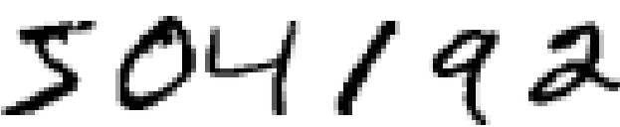

A simple network to classify handwritten digits

Slide 65
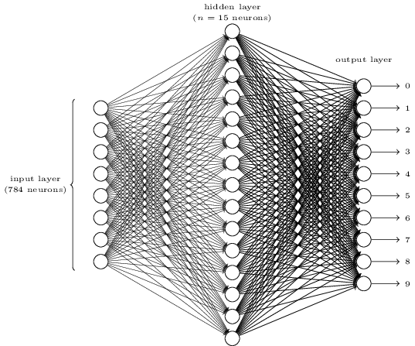
A simple network to classify handwritten digits

Slide 66
Demo

Slide 67
A simple network to classify handwritten digits
96.59% Accuracy
Is it good?
NO
How about 99% accuracy
Not for banks
The best commercial neural networks are now so good that they are used by banks to process cheques, and by post offices to recognize addresses

Slide 68
Too hard!?
This is just the beginning!!!

Slide 69
Convolutional Neural Networks for Image classification

Slide 70
Introduction
Convolutional Neural Network (CNNs) → Computer Vision
Major breakthroughs in Image Classification
Core of most Computer Vision systems such as Facebook’s automated photo tagging and self-driving cars
Recently CNN where also applied to problems in Natural Language Processing
Interesting results

Slide 71
What is Convolution?

Slide 72
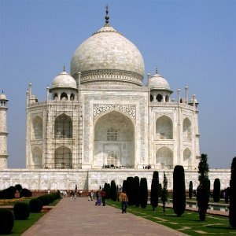
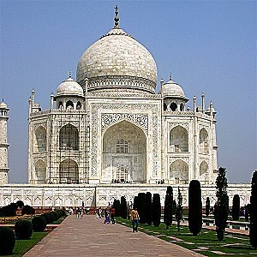
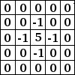
What is Convolution?
Sharpen

Slide 73

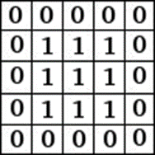
What is Convolution?
Blur

Slide 74
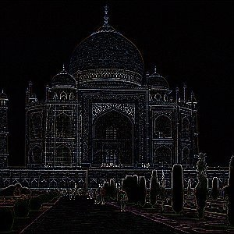
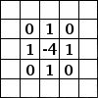
What is Convolution?
Edge detect

Slide 75
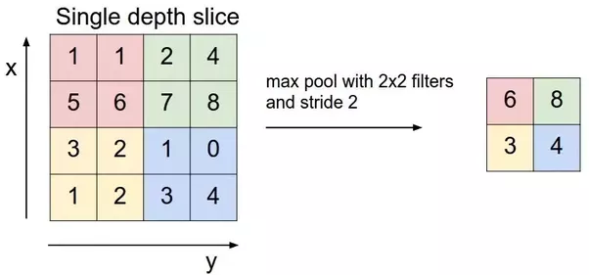
Pooling Layer

Slide 76
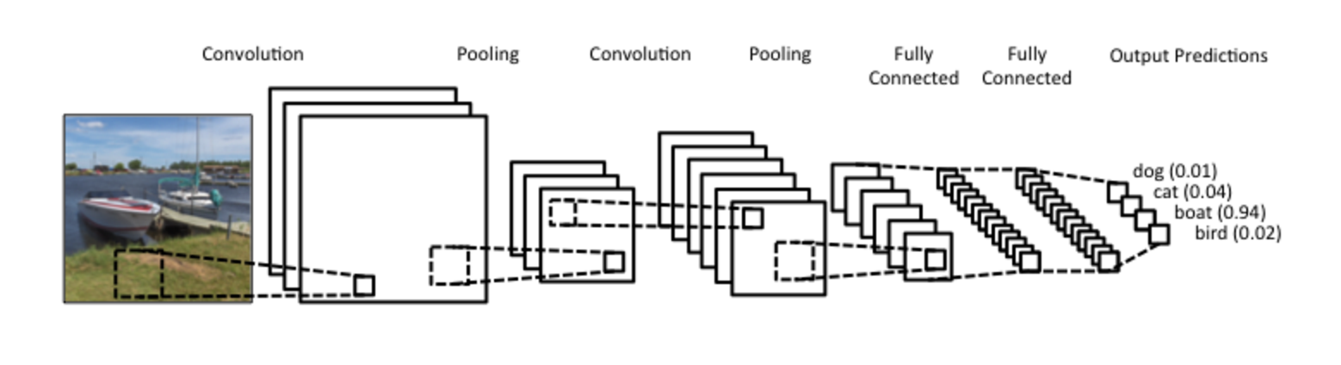
What are Convolutional Neural Networks?
Notes:
During the training phase, a CNN automatically learns the values of its filters based on the task you want to perform. For example, in Image Classification a CNN may learn to detect edges from raw pixels in the first layer, then use the edges to detect simple shapes in the second layer, and then use these shapes to deter higher-level features, such as facial shapes in higher layers. The last layer is then a classifier that uses these high-level features.

Slide 77
Convolutional Neural Networks for Sentence Classification
Demo

Slide 78
AlphaGo

Slide 79
Introduction
Each location on the board can be either empty, black, or white
3^{N} possible board positions on a board with N intersections
19×19 board has
208 168 199 381 979 984 699 478 633 344 862 770 286 522 453 884 530 548 425 639 456 820 927 419 612 738 015 378 525 648 451 698 519 643 907 259 916 015 628 128 546 089 888 314 427 129 715 319 317 557 736 620 397 247 064 840 935
legal position
In short, 2.~~~×10¹⁷⁰
The Universe has 10⁸⁰ atoms

Slide 80
Introduction
Brute force search intractable:
Search space is huge
“Impossible” for computers to evaluate who is winning

Slide 81
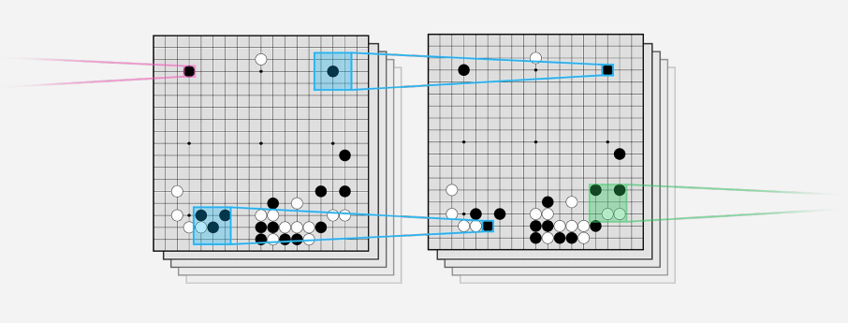
Convolutional Neural network

Slide 82
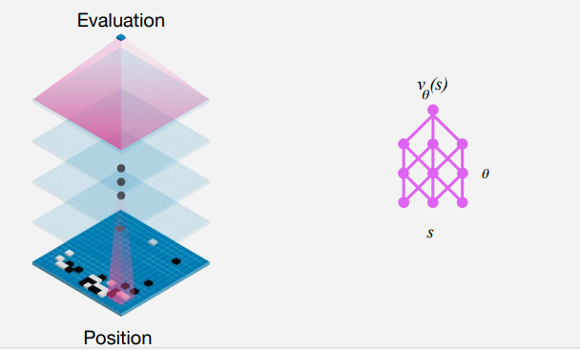
Value network

Slide 83
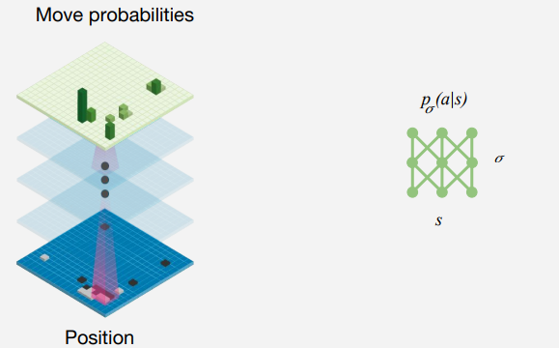
Policy network

Slide 84
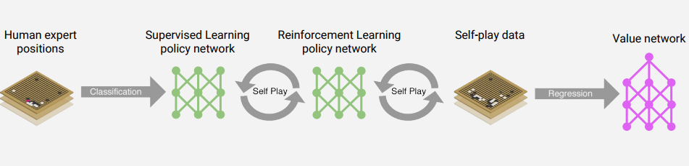
Training pipeline

Slide 85

Supervised learning of policy networks
Policy network: 12 layer convolutional neural network
Training data: 30M positions from human expert games
Training algorithm: maximize likelihood by stochastic gradient descent
Training time: 4 weeks on 50 GPUs using Google Cloud
Results: 57% accuracy on held out test data (state-of-the art was 44%)

Slide 86

Reinforcement learning of policy networks
Policy network: 12 layer convolutional neural network
Training data: games of self-play between policy network
Training algorithm: maximize wins z by policy gradient reinforcement learning
Training time: 1 week on 50 GPUs using Google Cloud
Results: 80% vs supervised learning

Slide 87

Reinforcement learning of value networks
Value network: 12 layer convolutional neural network
Training data: 30 million games of self-play
Training algorithm: minimize MSE by stochastic gradient descent
Training time: 1 week on 50 GPUs using Google Cloud
Results: First strong position evaluation function - previously thought impossible

Slide 88
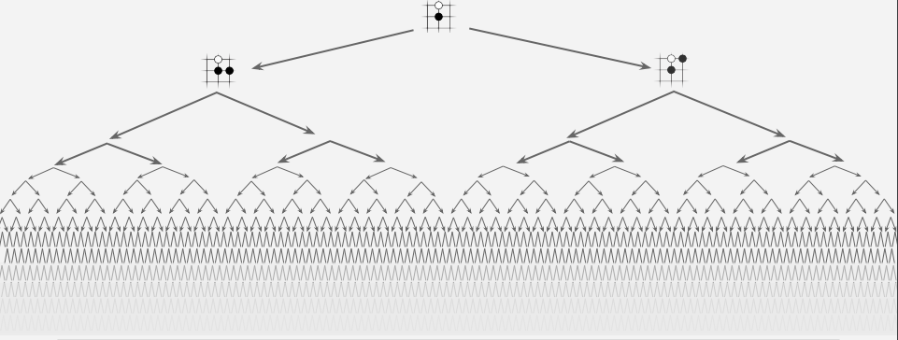
Exhaustive search

Slide 89
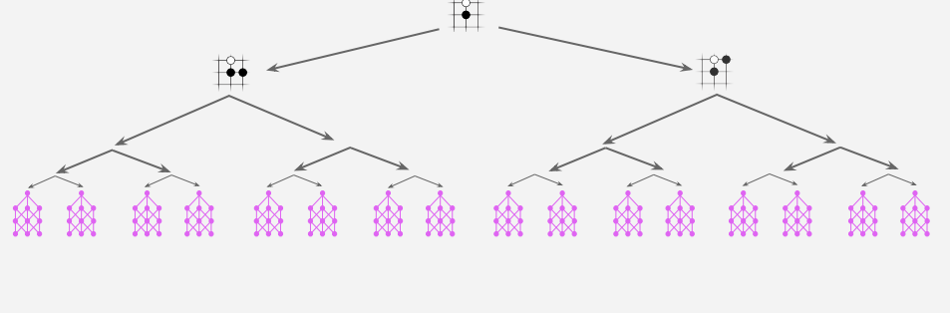
Reducing depth with value network

Slide 90
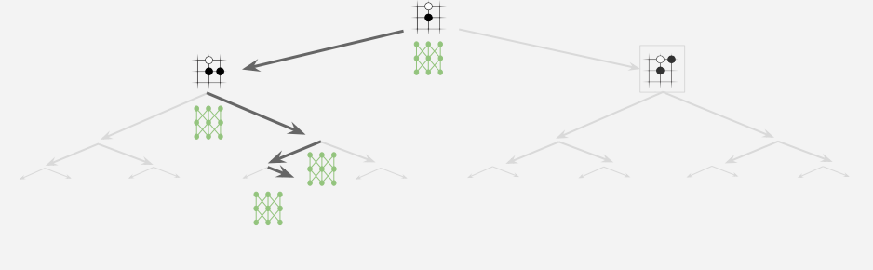
Reducing breadth with policy network

Slide 91
Conclusion
“People worry that computers will get too smart and take over the world, but the real problem is that they're too stupid and they've already taken over the world.” ― Pedro Domingos
“Karma of humans is AI” ― Raghu Venkatesh
Before we work on artificial intelligence why don’t we do something about natural stupidity?” —Steve Polyak
“Some people worry that artificial intelligence will make us feel inferior, but then, anybody in his right mind should have an inferiority complex every time he looks at a flower.” —Alan Kay

Slide 92
Thanks for listening.
Q/A?

Slide 93
References
The internet
http://neuralnetworksanddeeplearning.com/

